Slide 1
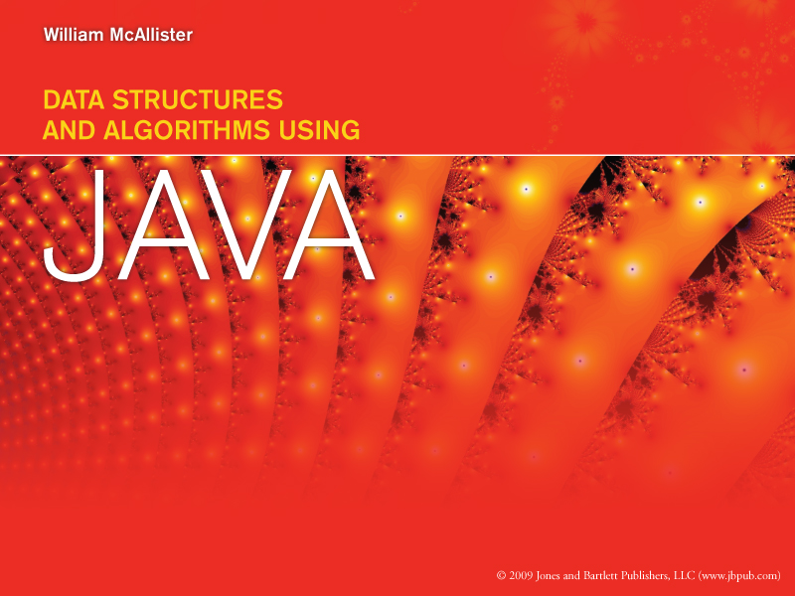
Chapter 1
Overview and Java Review

Slide 2

How To View This Presentation
This presentation is arranged in outline format. To view the slides in proper order
For each slide
  Read the entire slide’s text
  Then click the links (if any) in the text, in the order they appear in the text
  Then click the or button at the bottom-right side of the slide

Slide 3
Overview of Data Structures
Topics
  Data and data structures
  Selecting a data structure for an application
  Fundamental concepts
  Performance calculation techniques
Java Review

Slide 4
Data
Data is information
    Information input to, generated by, or output from a program
    e.g., your name, or address, or telephone number
Typical sources and destinations of data
    the user, disk files, other computers, and the web
Programs process data
Input data
Process
Output data

Slide 5
Data Structures
An organization of information, usually in memory, for better program efficiency
80% of all processing time is spent locating data
A good data structure
  Facilitates the operations on the data base
  Is frugal in use of memory i.e.
    Total memory requirement is less than 125% of the data base size

Slide 6
Selecting a Data Structure for an Application
Selection can greatly impact program performance (its speed and memory requirements)
Selection is made during the Design Phase based on:
  The application’s performance requirements
  The performance of the candidate structures
  Cost of Implementation
Using a trade-off process

Slide 7
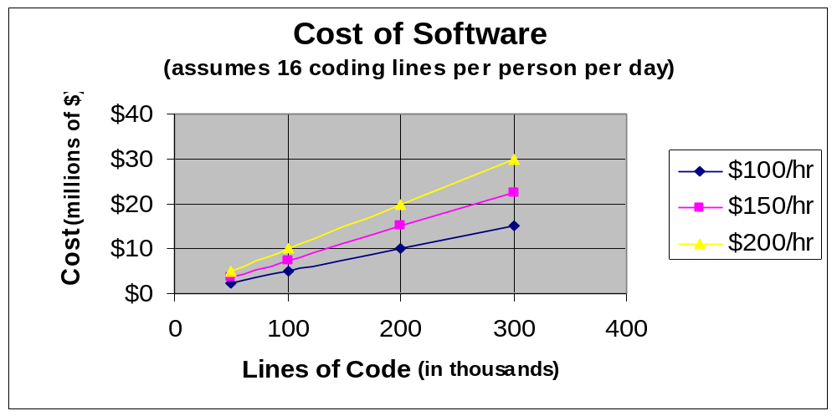
Cost of Software
Based on burdened labor rates
  Includes salaries, benefits, rent, utilities, profit, etc.

Slide 8
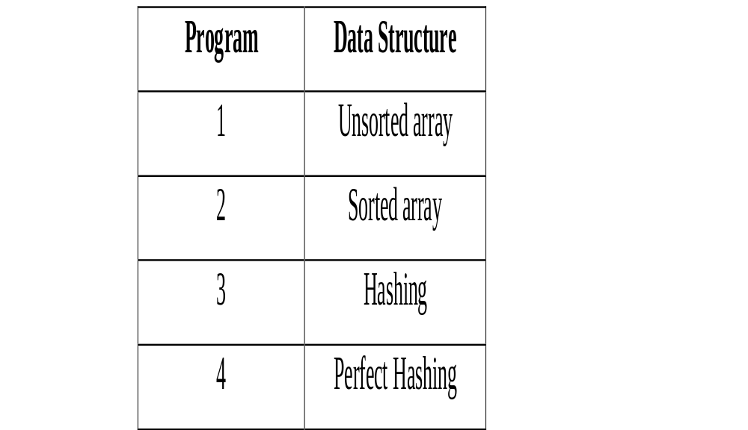
Four Telephone Directory Programs Utilizing Different Data Structures
Their Performance

Slide 9
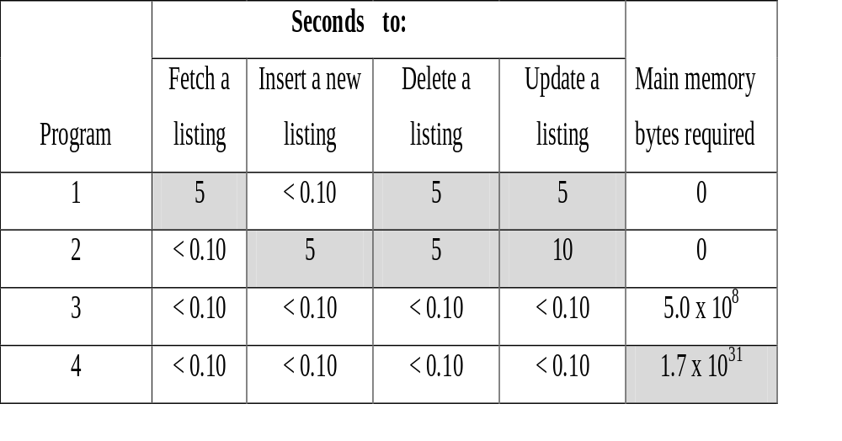
Performance Differences of the
Four Telephone Directory Programs
Gray areas of table indicate unacceptable performance

Slide 10
Trade-Off Process to Select the Telephone Directory Program’s Data Structure
Two array-based structures eliminated based on speed requirements
Perfect hashing eliminated based on memory requirements
Hashing structure cost is acceptable
4 candidate structures
Speed Analysis
2 remaining candidate
structures
Memory Overhead Analysis
Cost Analysis
1 remaining candidate structure
an acceptable structure

Slide 11
Fundamental Concepts
Shared By All Data Structures
Terminology
The operations performed on the information
How to specify which information is to operated on; operation access modes
The concepts of abstraction and encapsulation

Slide 12
Terminology of Data Structures
Field
  An indivisible piece of data (e.g., a phone number)
Node
  A group of related fields (e.g., Al’s name, address and phone number)
Key field
  Contents of this field identifies a particular node (e.g., the name field in a telephone directory data base)
Homogeneous data set
  All node have the same fields (“look” the same)

Slide 13
Operation Access Modes
Used to specify which node is to operated on
Two modes: Key Field and Node Number
Key field mode
  Specify contents of the node’s key field
  e.g., “Fetch Al’s node”
Node number mode
  Specify the number of the node
  e.g., “Fetch node number 31”

Slide 14
Fundamental Operations Performed on
Data Structures
Insert – Add a node to the structure
Fetch – Retrieve a node form the structure
Delete – Eliminate a node from the structure
Update – Change the information of a node in the structure
(Update can be thought of as a Delete operation followed by an Insert operation)

Slide 15
Abstraction
The idea of knowing how to use something without knowing how it is implemented
  We all use cars, but few of us could design and build one
  Applies to methods and data structures
Two types of abstractions in computer science
  Procedural abstraction
  Data abstraction (Abstract Data Types, ADTs)

Slide 16
Procedural Abstraction
The idea that to use a method
  We need only need to know
    What is does (to decide when to invoke it)
    How to invoke it (its signature)
  We need not know how it works (its algorithm)
This allows us to build upon other peoples
  Knowledge (algorithms) and
  Efforts (method coding and debugging)
Thus reducing the cost of software

Slide 17
Data Abstraction
(Abstract Data Types)
The idea that to use a data structure
  We only need to know
    What the operation methods do (to decide when to invoke them)
    How to invoke the operation methods (their signature)
  We need not know the operation algorithms
This allows us to build upon other peoples
  Knowledge (algorithms) and
  Efforts (data structure implementation and debugging)
Thus reducing the cost of software

Slide 18
Standard Abstract Data Type
An ADT whose method signatures conform to a standard
Advantage is that an application’s data structure can be changed by changing
  The declaration of the data structure object
  Not the operation method invocations
Greatly reduces the cost of software maintenance

Slide 19
Encapsulation
Writing programs in a way that establishes compiler enforced protocols for accessing their data
Techniques
  Elimination of global variables
  Bundling the data and the data operation methods into a class construct
Reduces software cost
  Testing and debugging is simpler and more efficient
  Increases software reusability (easily imported)

Slide 20
Encapsulation of Data Within An Object
Data Storage
An encapsulated object
data operations
Operation methods
operation method invocations and data transfers
Program (Client) Code
Direct access to the data from the program is not allowed

Slide 21
Performance Calculation Techniques
Made to determine the
  Speed of a data structure’s algorithms, called Speed Complexity
  The average speed of a data structure
  Memory requirements of a data structure, called Space Complexity

Slide 22
Speed Complexity
The speed of a data structure’s operation algorithms
Approximated using Big-O analysis
Two speed measures
  Relative speed - used to determine which of several candidate algorithms is the fastest
  Absolute speed - used to determine if the speed of a particular algorithm is adequate

Slide 23
Big-O Analysis
Used to bound the upper limit of a mathematical function
Based on the assumption that one term of the function will dominate the function as the independent variable, n, gets large
Denoted
  O(n) if a linear term dominates the function
  O(n^2) if a quadratic term dominates the function
  O(log n) if a logarithmic term dominates the function

Slide 24
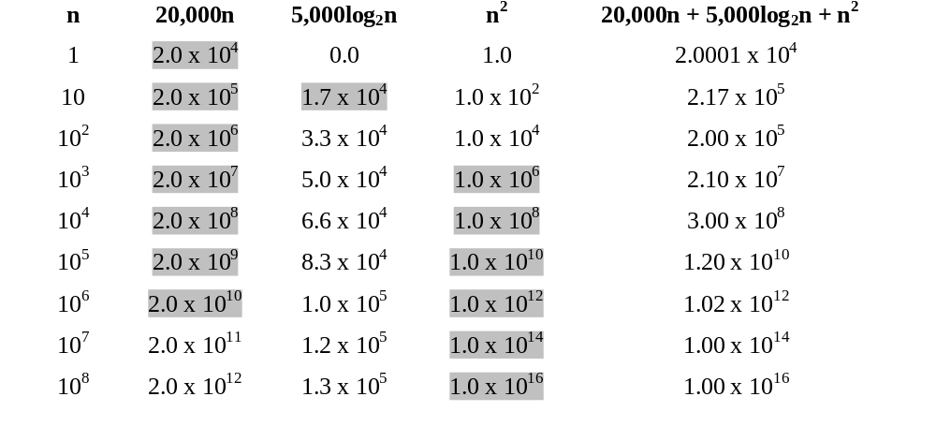
Justification for Big-O Analysis
Using a O(n^2) Function
The Functions Terms’ Values
The Function’s Value
Shaded values indicate > 1% contribution to function value. Above n = 10^8 only the term n^2 contributes more than 1% of the value of the function

Slide 25
Relative Speed
Determines which of several candidate algorithms is the fastest
Fastest algorithm is the one with the smallest Big-O value
Algorithms are analyzed to determine their Big-O value

Slide 26
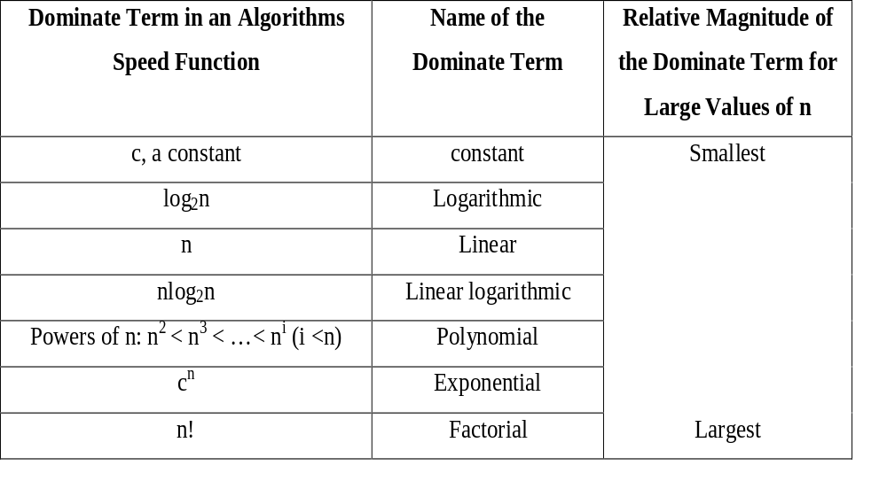
Common Algorithm Complexity Terms

Slide 27
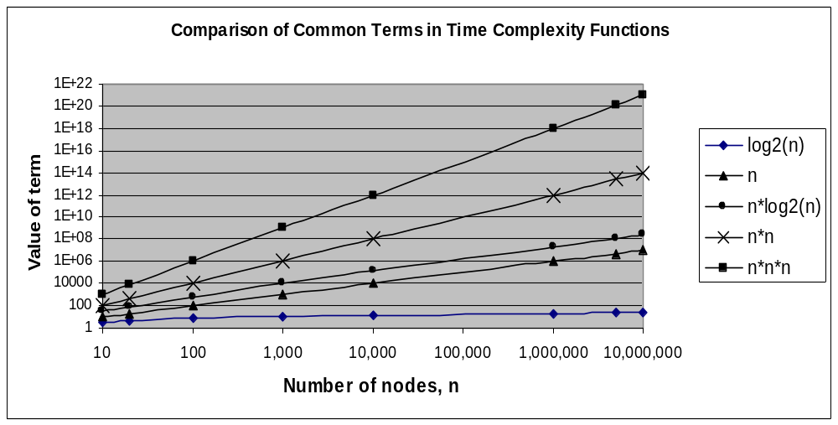
Comparison of Growth Rates of Common Algorithm Complexity Terms

Slide 28
Relative Algorithm Speed
Analysis Technique
Look for the inner most nested loop
Determine the maximum number of times this loop executes as a function of n, the maximum value of the loop variable(s). (For data structures, n is often the number of nodes in the structure)
The Big-O value of the function is the relative speed
For example, the binary search algorithm is O(log2n)

Slide 29
Binary Search Algorithm
low = 0;
high = n - 1
i = (high - low) / 2;
while (searchValue != data[i] && high != low)
{ if(searchValue < data[i])
{ high= i - 1 } // move high down to eliminate the upper half of the sub-array
else
{ low = i + 1 } // move low up to eliminate the lower half of the sub list
i = (high + low) / 2;
}
If n is the size of the array, the while loop executes a maximum of log2(n-1) times

Slide 30
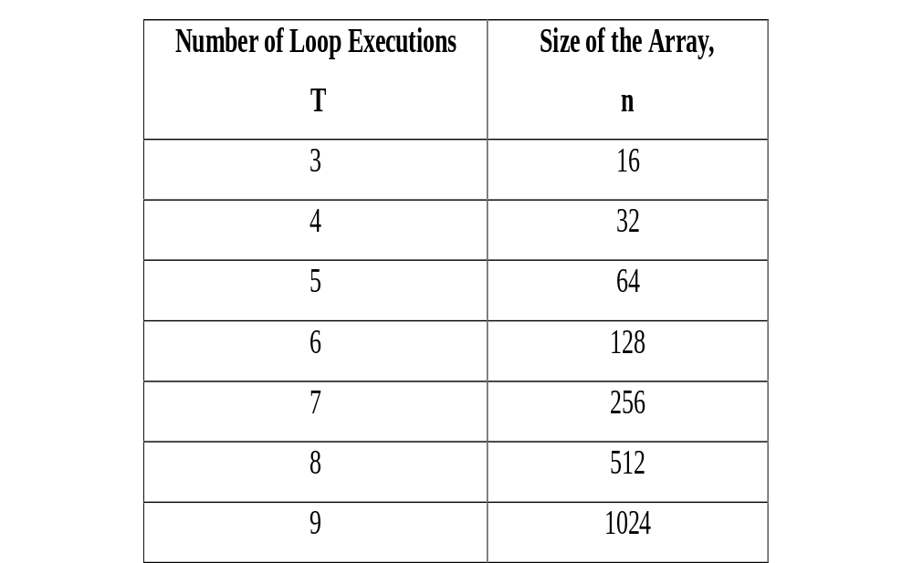
Determination of the Maximum Number of Times the Binary Search Loop Executes
Generalizing T = log2n

Slide 31
Absolute Speed
Used to determine if the speed of an algorithm is adequate
Calculated as the sum of the times to execute each machine language instruction in the algorithm’s translation
Simplest case, two types of instructions:
  The non-memory access instructions
  The memory access instructions

Slide 32
Absolute Speed Calculation Example:
Total A Two Dimensional Array
row = 0; t = 0;
while( row < n)
{ column = 0
while( column < n)
{ t = t + data[row, column]
column = column + 1
}
row = row + 1
}
This algorithm takes 0.0515 seconds to execute assuming:
  non-memory access instruction require 0.5 nanoseconds
  memory access instructions require 50 nanoseconds,
  the array data is 1,000 x 1,000 elements (n = 1000)

Slide 33
Average Speed of a Data Structure
Calculated as the frequency weighted average of the time to perform the structures four operations
tavg = t1*p1 + t2*p2 + t3*p3 + t4*p4
where: ti is the time for the ith operation
pi is the probability of the ith operation
The sum of the probabilities must add up to 1 (e.g., 0.25 + 0.3 + 0.25 + 0.2).

Slide 34
Space Complexity of a Data Structure
The memory requirements of a data structure
The less memory the better
The metric of a data structures space complexity is density

Slide 35
Density of a Data Structure
Density, D, is a measure of how efficiently the structure uses memory
Calculated as:
D = information bytes / total bytes
= information bytes / (information bytes + overhead)
where: overhead is the number of bytes required to
maintain the structure
Because overhead is always > 0, 0 < D < 1
Efficient structures have densities > 0.8

Slide 36
A Density Calculation Example
200 nodes each containing 100 information bytes are stored in a structure that requires 4 additional bytes per node to keep track of the node locations. The structure’s density would be:
D = (200*100) /(200*100 + 4*100) = 0.98
This a very efficient structure from a space complexity viewpoint

Slide 37
Java Review
Arrays of primitives
Classes and Objects
Method naming prefixes
Copying objects
Arrays of objects
Containership
Inheritance
Generics
End Presentation

Slide 38
Arrays of Primitives
The primitives types are:
  boolean, byte, short, long, char, float, double
Primitive array declaration syntax
dataType[] arrayName;
arrayName = new dataType[arraySize];
Or
dataType[] arrayName = new dataType[arraySize];
Example, a three element integer array:
int[] numbers = new int[3];

Slide 39
Primitive Array Memory Model
Statement Memory Allocated
int[ ] numbers;
numbers = new int [3];
null 100
numbers
0
0
←address 100
1
0
2
0
indexes
Memory allocated by the declaration
int[] numbers; // allocate reference variable numbers
numbers = new int[3]; // allocate the array of integers

Slide 40
Classes and Objects
A class is a programmer defined type that contains methods and data definitions
A constructor is a
  Method in a class,
  Whose name is the same as the class name,
  Invoked to create an object in the class
An object is an instance of a class
  Contains variables for the class’ data definitions

Slide 41
Syntax Of A Class Definition
public class ClassName
{ // definition of data members
// definition of member methods (subprograms)
}// end of class ClassName
Penmanship issues
  Class names begin with a capital letter
  Constructors are the first methods coded
  Names of methods begin with lower case letters

Slide 42
An Example of a Class Definition
      public class Person
      { // definition of the data members
      private int age;
      private double weight;
      // definition of member functions
      public Person(int a, double w ) // the constructor
      { age = a;
      weight = w;
      } // end of constructor
      public String toString( ) // returns annotated data values
      { return( “this person’s age is: “ + age +
      “\nand their weight is: “ + weight);
      } // end of toString method
      } // end of Person class
The class contains two data members, age and weight
private data access maintains data encapsulation

Slide 43
Declaring and Object
(An Instance of a Class)
Syntax
ClassName objectName; // declares a reference variable
objectName = new ClassName(argumentList); // declares an object
Example
Person tom; // allocates a reference variable named tom
tom = new Person(25, 187.6); // creates a Person object and
// places its address into the
// reference variable tom

Slide 44
Object Memory Model
Person tom;
tom = new Person(25, 187.6);
tom
null 100
age
25
weight
187.6
Memory allocated by the declaration
Person tom;
tom = new Person(25, 187.6);

Slide 45
Operating on Objects
To operate on an object, we invoke the object’s methods
The invocation specifies the particular object to be operated on
Syntax:
objectName.methodName(argumentList)
Example that outputs Tom’s data
System.out.print(tom.toString())

Slide 46
Class Method Naming Prefixes
Improves readability of programs
  input and set prefixes imply transmission of data values to the class
  set, show, toString prefixes imply transmission of data values from the class
I/O Device
Client Code
show
get
set
toString
input
Code of a method in a class

Slide 47
set, get, input And show Methods
For The Class Person
public int getAge( ) public void setWeight(double w)
{ return age; { weight = w;
} }
public void input()
{ String in;
in = JOptionPane.showInputDialog(“enter age”);
age = Integer.parseInt(in);
in = JOptionPane.showInputDialog(“enter weight”);
weight = Double.parseDouble(in);
}
public void show()
{ Sytem.out.println(this.toString);
}

Slide 48
Copying Objects
There are two ways to “copy” an object
  Deep copy creates a clone of the object
    The objects data values are copied into the clone
  Shallow copy creates reference to the object
    The location of the object is copied into a reference variable
After a
  Deep copy, two distinct objects exist
    Can change one object’s data without changing the other’s
  Shallow copy two reference to one object exists

Slide 49
Memory Model of Two Types of Copies
tom
mary
100
200
location 100
location 200
age
25 21
21
age
weight
deep copy
weight
187.9 127.3
127.3
A Deep Copy of the Object mary into the Object tom
tom
mary
100 200
shallow copy
200
location 200
21
127.3
A Shallow Copy of the Object mary into the Object tom

Slide 50
Code of Shallow and Deep Copies
Shallow copy is similar to copying primitives
  tom = mary;
Deep copy
  requires a class method (e.g., in the Person class)
public Person deepCopy()
  { Person clone = new Person();
  clone.age = age;
  clone.weight = weight;
  return clone;
  }
  Invoked as
  tom = mary.deepCopy(); //copy mary into tom

Slide 51
Arrays of Objects
Three step declaration for n objects
  1- Declare a variable to store the array address
  2- Declare an array of n reference variables
  3- Declare the n objects and store their addresses in the array elements
Example
Person[ ] employee; // Step 1
employee = new Person[3]; // Step 2
for(int i = 0; i < 3, i++) // Step 3
employee[i] = new Person(25, 187.6);

Slide 52
The Memory Model of an Array of Objects
employee
null 50
Person[ ] employee;
location 50
null 100
null 200
null 300
employee = new Person[3];
age
25
age
25
age
25
weight
187.6
weight
187.6
weight
187.6
for (int i=0; i< 3, i++);
employee[i] = new
Person(25, 187.6);
location 100
location 200
location 300
Three Person objects

Slide 53
Containership
Objects that reference other objects
  The class definition declares reference variables
  The class’ constructor usually allocates the objects
public class WeightLossClass
{ private Person person1, person2, person3;
public WeightLossClass(int a1, double w1, int a2,
double w2, int a2, double w3)
{ person1 = new Person(a1, w1); // allocate three Persons
person2 = new Person(a2, w2);
person3 = new Person(a3, w3);
} // end of constructor
} // end of WeightLossClass class

Slide 54
Containership Memory Model
class1
person1
person 2
person 3
a WeightLossClass object
age
age
age
32
age
21
54
32
3 Person objects
weight
weight
weight
250
weight
400
300
400
A WeightLossClass Object Containing Three
Person Object References

Slide 55
Inheritance
The concept of a new class (child class) that expands an existing class (parent class)
The child class
  Has all the data and methods of the parent class
  Adds data or methods
  Contains the keyword extends in its heading
  Can write its own version of the parent’s method(s)
Saves work and protects parent source code
  Do not need the source code of the parent, only the byte code (.class) file

Slide 56
Syntax of Inheritance
To define a child class WeightLossClient that inherits from the parent class Person we write:
public class WeightLossClient extends Person
{ // additional member data are coded here
private double goalWeight;
// additional member methods are coded here
public double getGoalWeight()
{ return goalWeight;
} // end of getGoalWeight method
} // end of WeightLossClient class

Slide 57
Parent and Child Reference Variables
These variables follow a family axiom:
  “parents can point to children, but children can never point to parents”
A parent reference variable can store the address of a parent or a child object
A child reference variable can store the address of a child object, but not a parent object
Child object addresses stored in parent reference variables can be coerced into child reference variables:
childRefVar = (ChildClass) parentRefVar;

Slide 58
Generics
A language feature for generalizing the type of data a method or class will process
The data types are specified by the code
  That invokes of the method
  That declares an object in the class
Method parameter types or class data types can be generic types

Slide 59
Generic Methods
A generic placeholder (e.g., <T>) is coded in the method heading and used in the parameter list
Invoker’s argument(s) type is substituted for the generic place holder at run time.
E.g., generic code to output an array of any type of primitive (int, float, double, char, etc.)
public static <T> void outputNumericArray( T[] array)
{ for(int i=0; i< array.length; i++)
System.out.println(array[i]);
}

Slide 60
Generic Classes
A generic placeholder (e.g., <T>) is coded in the class’ heading and used in the class’ code
Types used in an object declaration is substituted for the generic place holder at run time.
  Assuming there are two generic types in the class PersonGeneric, an instance declaration would be:
PersonGeneric <Integer, Double> bill = new PersonGeneric
<Integer, Double> (10, 102.56);
PersonGeneric Class Definition

Slide 61
Generic Class Code
public class PersonGeneric <T, E>
{ // definition of the data members
private T age;
private E weight;
// definition of member functions
public PersonGeneric(T a, E w ) // the constructor
{ age = a;
weight = w;
}
public String toString( )
{ return( "this person’s age is: " + age +
"\n and their weight is: " + weight);
} // end of toString method
} // end of Person class
For the declaration on the previous slide, Integer and Double will be substituted for placeholders T and E respectively

Slide 62


The End
Return to, Overview or Java Review

